Slide 1
urop.io
Deborah Chen, Dwyane George,
Naim Luján & Yi-Shuian Tung
Notes:
Yi-Shuian

Slide 2

State of UROPs at MIT
Beneficial for students and professors
85% students do at least one UROP
So why is the process to get one so painful?
Notes:
Source: http://wiki.mitadmissions.org/UROP, Yi-shuian

Slide 3
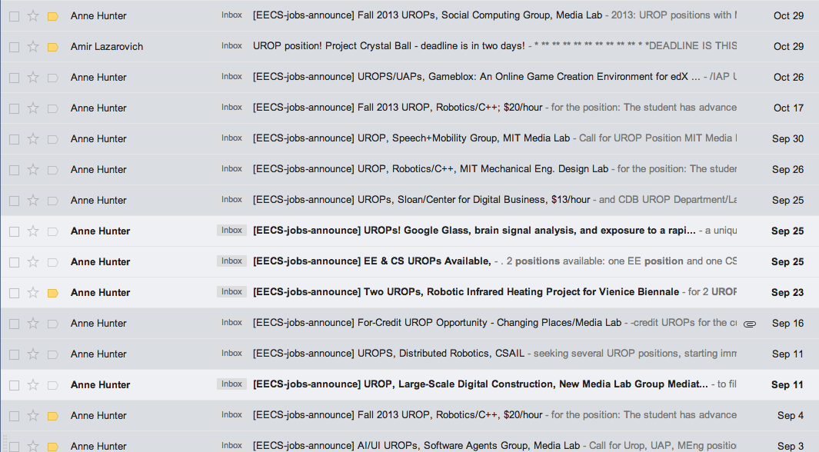
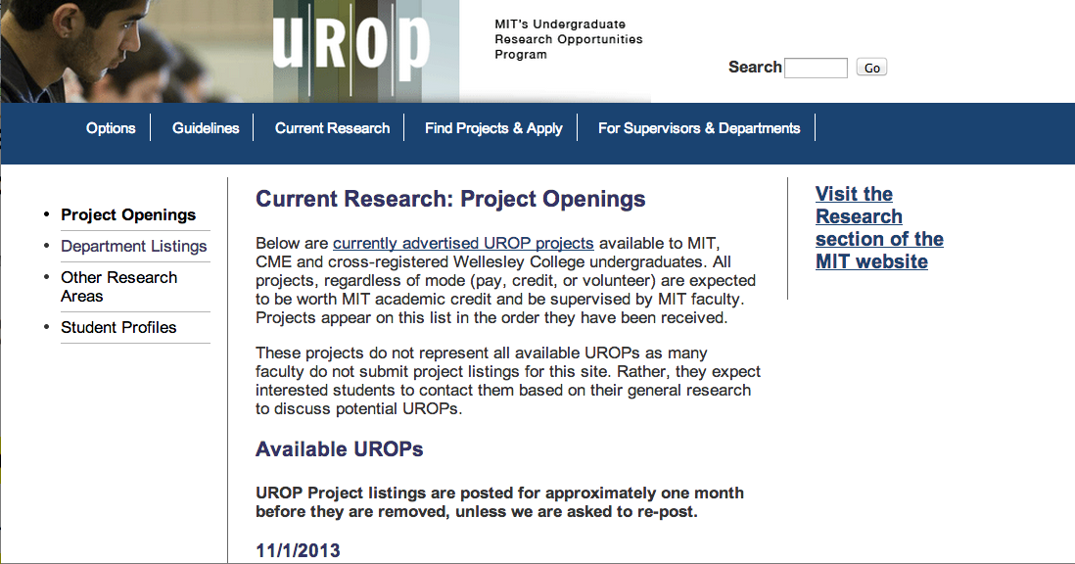
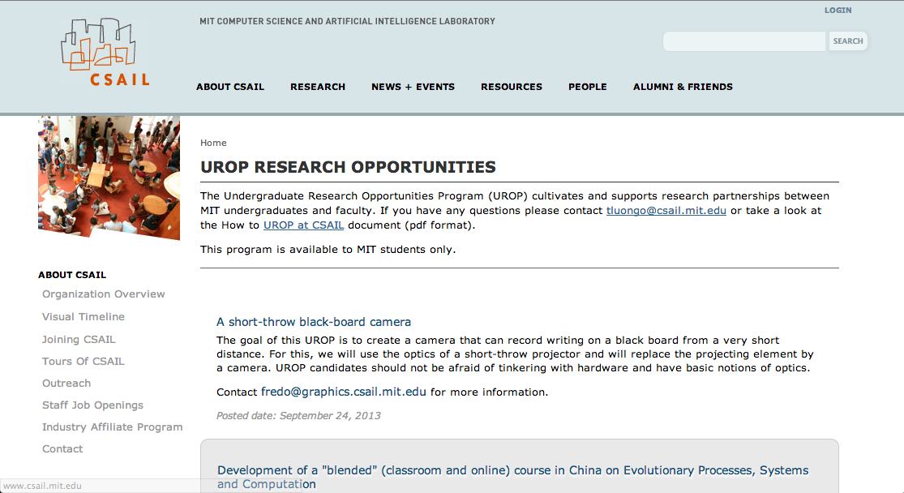

Confused freshman
Notes:
Yi-shuian
Find right posting
Intimidating to apply
Which one do you pick when you get multiple offers?

Slide 4


Daniel Jackson
Find the UROP!
Notes:
Dwayne
Publicize posting
Getting applicants
Larger applicant pool. Helps them be more selective

Slide 5
Goal
Help students find the right UROP project
Help faculty find the right student
Streamline process
Notes:
Dwayne

Slide 6
Concepts
Student
MIT undergrad
Faculty member
Professor, postdoc, research scientist
UROP
Research opportunity sponsored by a faculty member
Posting
Description of UROP, written by faculty member
Application
Resume + note submitted by student to a posting, reviewed by faculty
Notes:
Naim

Slide 7
How it works
STUDENT
PROFESSOR
Student views UROP postings & reviews
Applies to UROPs based on reviews & interests
Faculty members sees list of applicants
Student rates UROP experience
Student successfully obtains UROP!
Faculty members contacts appealing applicants
Notes:
Naim

Slide 8
Risks and challenges
Design
Students hesitant to post reviews of UROPs: Hide reviews from faculty, anonymous
Ensure applicants are serious: Require upload resume when create account
Implementation
Tagging & organizing UROPs: Allow search by dept, skills required, faculty to start
Development
Not able to find all listings of UROPs: Start with the listings on the UROP home page
Notes:
Deborah

Slide 9

Questions

